Slide 1




Ecommerce Shopping Store
IGATE is now a part of Capgemini
Notes:
Copyright © 2011 IGATE Corporation (a part of Capegemini Group). All rights reserved.
No part of this publication shall be reproduced in any way, including but not limited to photocopy, photographic, magnetic, or other record, without the prior written permission of IGATE Corporation (a part of Capegemini Group).
IGATE Corporation (a part of Capegemini Group) considers information included in this document to be confidential and proprietary.

Slide 2

Team Members
Samrudhi Gandhi
Aniket Salunke
Nikhil Kadam
Rahul Bane
Shubhangi Yadav

Slide 3

Project Details
Online shopping or e-shopping is a form of electronic commerce which allows consumers to directly buy goods or services from a seller over the Internet using a web browser.
Online shopping system In today’s busy world, people don’t have time for their personal needs. And the technology is so fast that anyone can do anything by just sitting in a room. The internet is the way that helps a person in all aspects.
Everything is going to be computerized and online whether it is banking, advertising or shopping. We are trying to help people to make their life easier by proving online shopping.
The admin module contains the access of admin on the application. The admin can change everything in the application. He have the ability to add, delete any information.

Slide 4
User Operation
User Registration : A User can register himself to appear in the Any Shopping and may login with his given E-mail Id and password.
User ’s Login : User’s can Shopping by entering his Email Id and password .
Buy Now : The facility provide to User that he can choose the which he wants to Purchase.
Get Result : When User finish his Shopping then click to Place order & checkout.

Slide 5
Diagram Depicting Entire Project

Slide 6
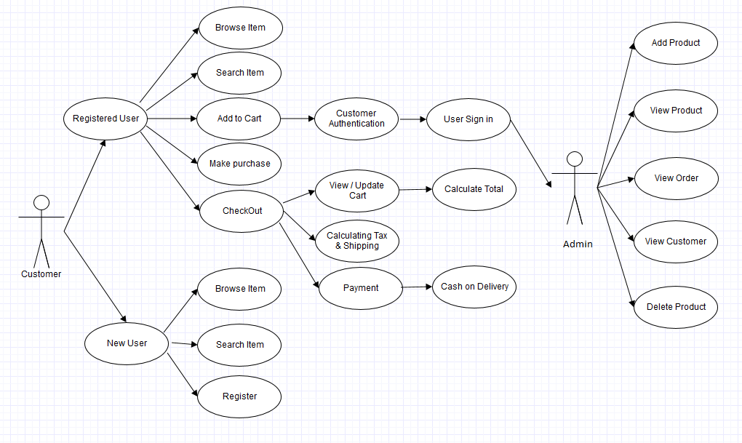
Use Case Diagram

Slide 7
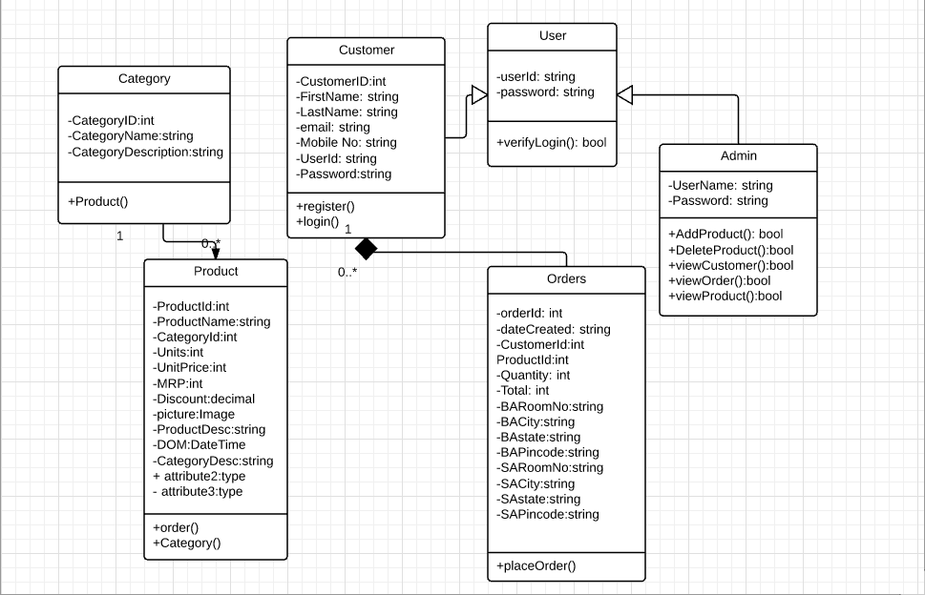
Class Diagram

Slide 8
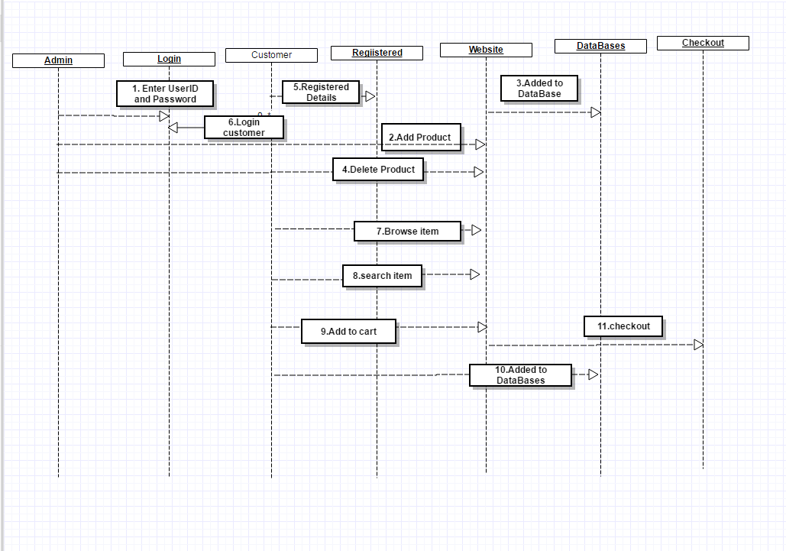
Sequence/Activity Diagram

Slide 9
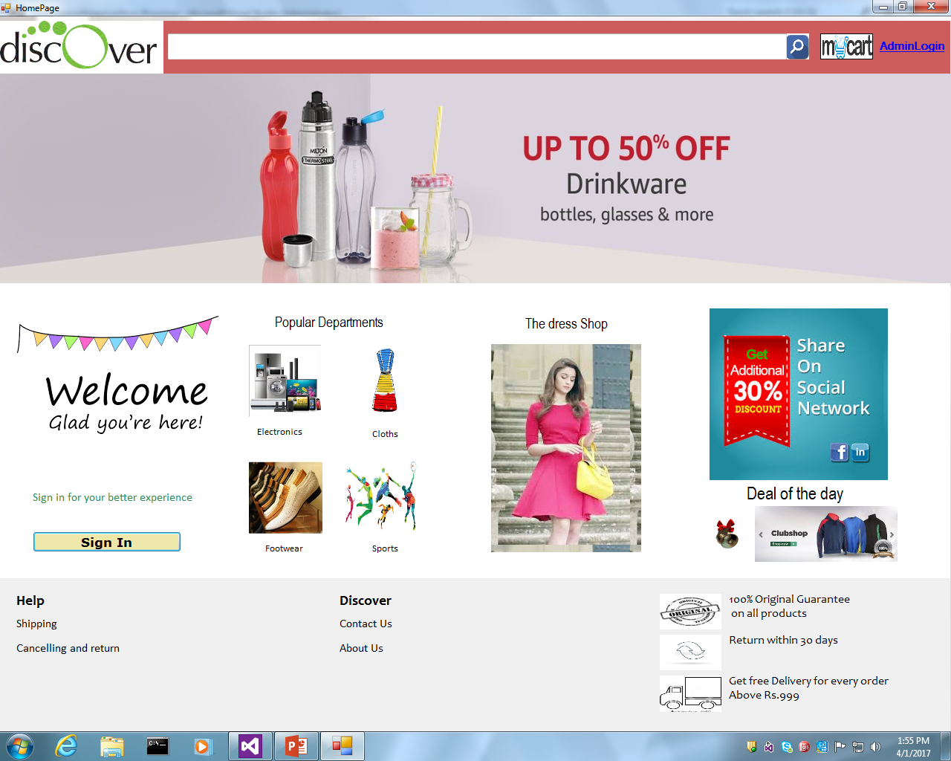
Staring page of website

Slide 10
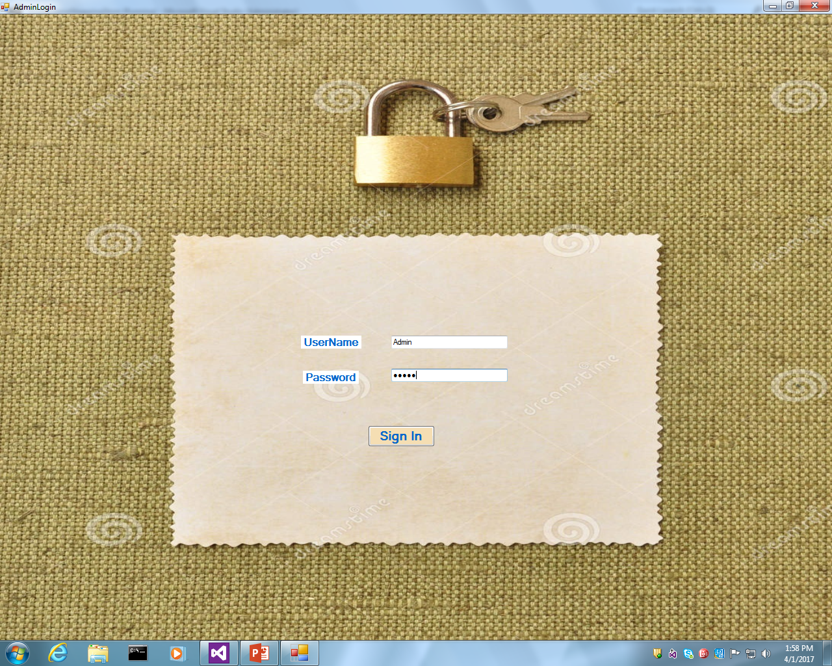
Admin Login

Slide 11
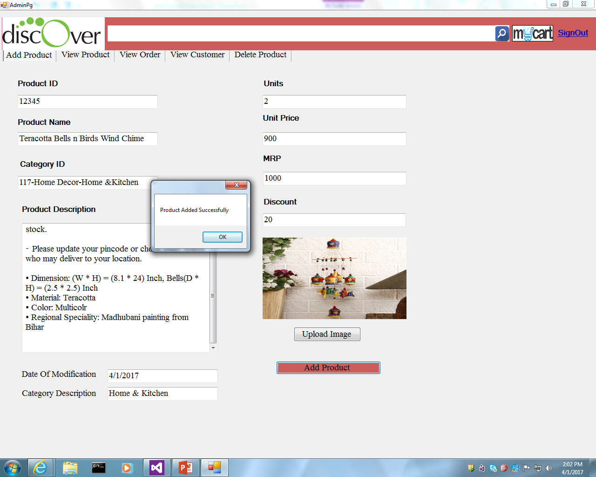
Admin -> Add Product

Slide 12
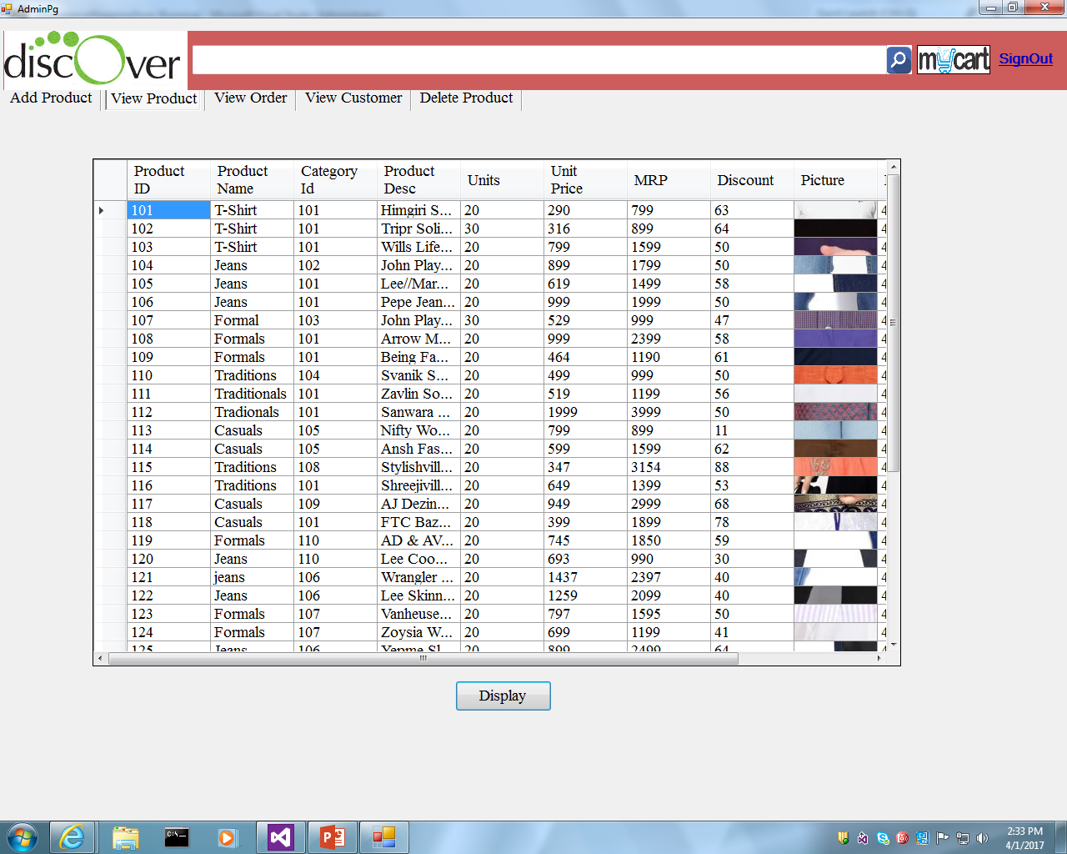
Admin -> View Products

Slide 13
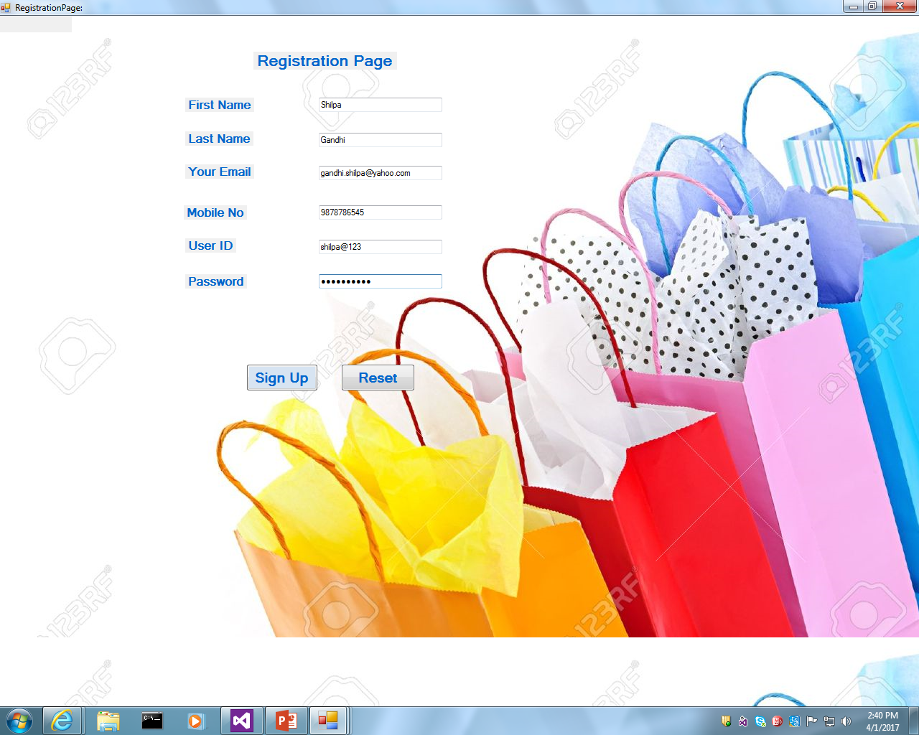
Registration Page

Slide 14
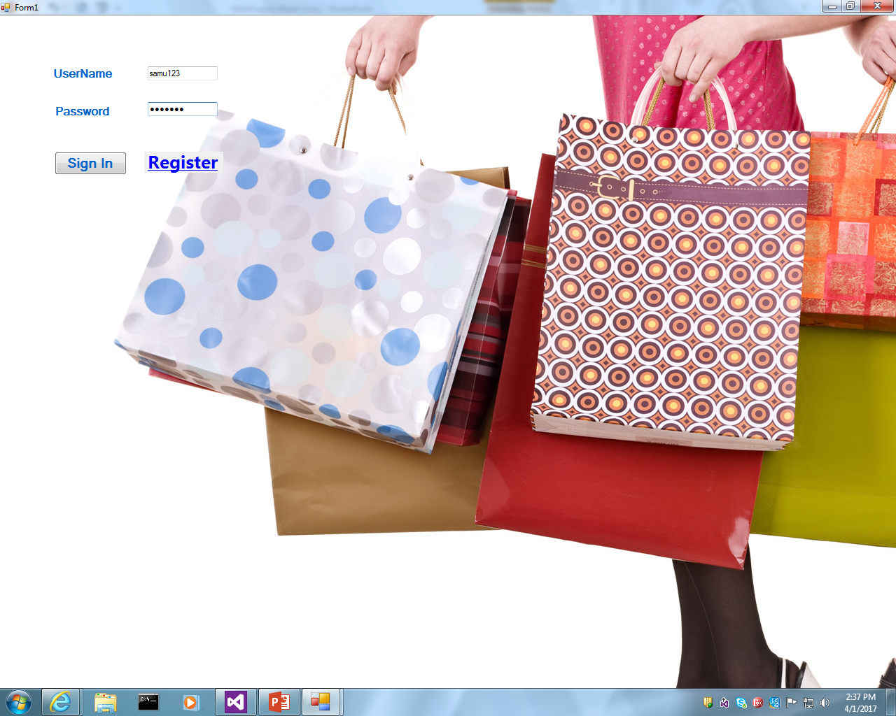
Customer Login

Slide 15
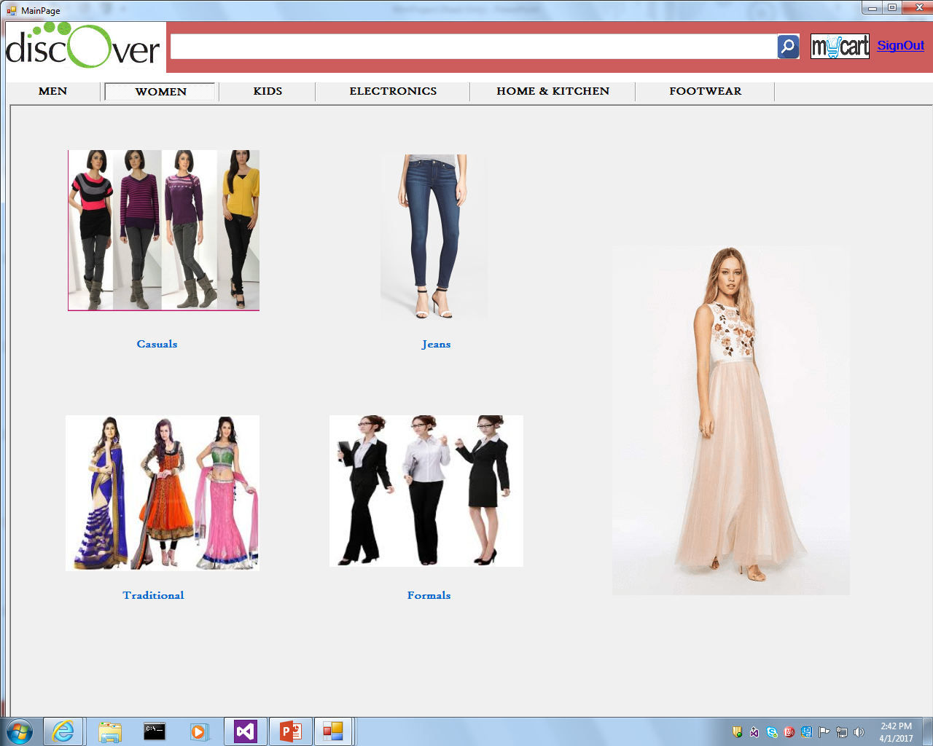
Home Page

Slide 16
Future Enhancements
SMS and MMS Feature –
To add on a function to send SMS and MMS automatically to notify the customers regarding promotional items of the day once the customers have entered the premise.
Providing online Placement Record through our site.
Providing personalized inbox to the user.
Providing video conferencing with the Artists.
Providing links to news which will elaborate more information about them.

Slide 17

Thanks
Questions

